Slide 1
Physician Wellbeing Resources
Provided by WAFP

Slide 2
Table of Contents
Burnout in physicians, residents, and medical students
Tips for Wellness
Depression
Suicide Prevention
Joy in Practice

Slide 3
Burnout is real
54% of Family Medicine doctors reported burnout at some point in their career.
Burnout negatively impacts patient care by leading to charting errors, diminished follow-up, and lack of concern for patient.
Mayo Clinic Proceedings 2015 90, 1600-1613DOI: (10.1016/j.mayocp.2015.08.023)

Slide 4
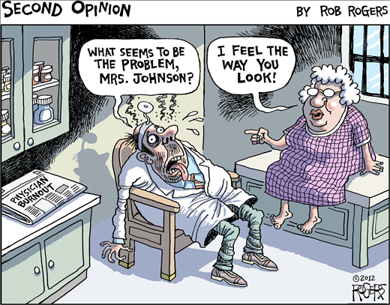
Burnout can be seen at any stage
Burnout has been reported in medical students (15%), residents (51%), and practicing physicians (46-54% in family medicine doctors).
David A. Rothenberger, Physician Burnout and Well-Being: A Systematic Review and Framework for Action. Diseases of the Colon & Rectum. 60(6):567–576, JUN 2017

Slide 5
What is wellness?
Wellness is the state of good health, with balance and poise in life and stressors
Many physicians find wellness hard to achieve, due to difficult schedules and demands upon them

Slide 6
Tips for Wellness
Meditation
Exercise
Maintaining hobbies
Social Links and Family/Support Relationships
Ability to ‘step away’ from work
Developing your ‘Healthy Mindset’ and clarifying your perspective

Slide 7
Are you helping, fixing or serving?
Rachel Remen, MD talks about the difference in a physician’s viewpoint as to how they treat a patient:
https://drive.google.com/open?id=0B-cjhPGEItnQN0JQdFQ1QzRpV28
Perspective has been shown to influence mindset and can contribute to burnout.
The difference between ‘helping’ (the physician in a position of power), ‘fixing’ (the patient seen as ‘broken’) and ‘serving’ (an equal relationship between physician and patient).

Slide 8
How to train yourself to be mindful
McConville, et al. 2017 mentions strategies for Mindfulness Training, and presents data on usage in medical students:
https://drive.google.com/open?id=0B-cjhPGEItnQaUEwdFgwbXVFR1E
Meditation was proposed as a way to lower perceived stress and lower depression and anxiety
Lower stress was correlated with increased patient communication scores

Slide 9
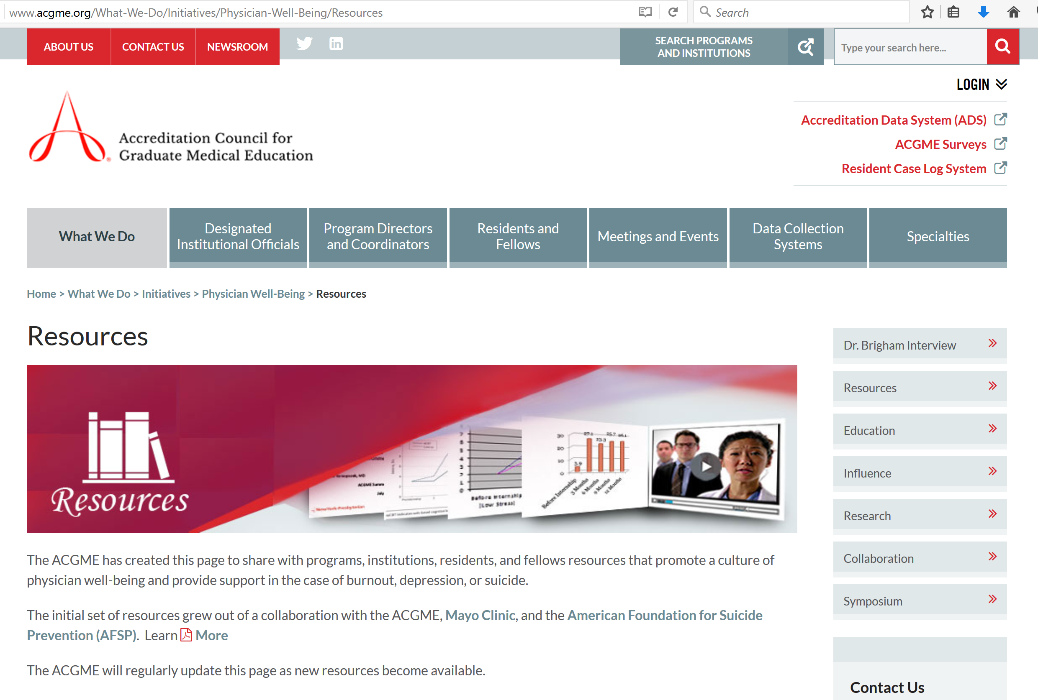
Accreditation Council for Graduate Medical Education Well-being Resources
http://www.acgme.org/What-We-Do/ Initiatives/Physician- Well-Being
These resources link with the American Society for Suicide Prevention and Mayo Clinic

Slide 10
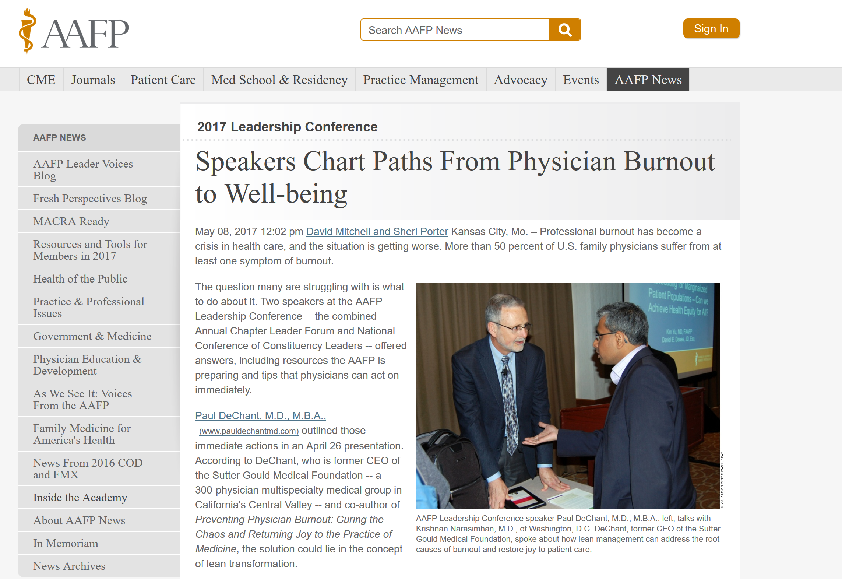
AAFP Physician Wellness
http://www.aafp.org/news/inside-aafp/20170508physicianwellness.html

Slide 11
Burnout and Depression - AAFP
Clif Knight describing Burnout and Depression:
https://drive.google.com/open?id=0B-cjhPGEItnQbExEN2RBOHdEbDA
Clif Knight and ways to treat it:
https://drive.google.com/open?id=0B-cjhPGEItnQa283MnFRSjZSTFk
Family Medicine and Burnout:
https://drive.google.com/open?id=0B2l-QFins8ofWFpzOGZRaEtEcjQ

Slide 12
Diana Phillips: Workplace contributions to Burnout
https://drive.google.com/open?id=0B-cjhPGEItnQY0JPTVhLeW1yVk0

Slide 13
Physician Depression
Rates of Depression and other mood disorders is higher in medical students, residents, and physicians (compared to the general population).
Despite working in a healthcare setting, a majority of these physicians suffering from mood disorders will not seek professional help.
Robert Bright and Lois Krahn, Depression and Suicide Among Physicians. Current Psychiatry. 2011 April;10(4):16-30

Slide 14
Robert Bright and Lois Krahn, Depression and Suicide Among Physicians. Current Psychiatry. 2011 April;10(4):16-30

Slide 15
Many physicians do not seek help
Especially seen in residents and women, seeking help is seen as a “weakness”.
Medical students, residents, and full physicians all cite lack of time as reason for not seeking help, as well as a perceived belief that such help would not be beneficial.
Prevention and early treatment considered ideal for depression
Robert Bright and Lois Krahn, Depression and Suicide Among Physicians. Current Psychiatry. 2011 April;10(4):16-30

Slide 16
National Suicide Hotline Telephone
Call 1-800-273-8255 (also an online chat option)
24 hours a day/7 days a week

Slide 17
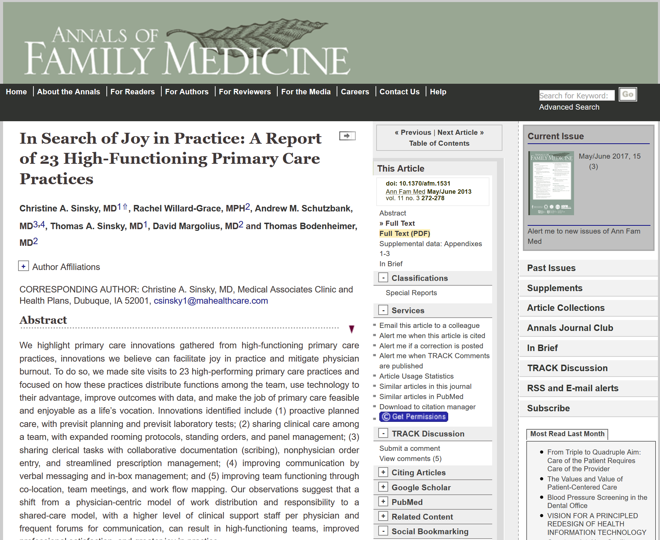
Joy of Practice
A list of ways to keep the joy of practice alive and avoid burnout

Slide 18
Joy of Practice - Summary
(1) proactive planned care, with previsit planning and previsit laboratory tests (2) sharing clinical care among a team, with expanded rooming protocols, standing orders and panel management (3) sharing clerical tasks with collaborative documentation (scribing), nonphysician order entry, and streamlined prescription management; (4) improving communication by verbal messaging and in-box management (5) improving team functioning through co-location, team meetings, and work flow mapping

Slide 19
1) Proactive planned care, with previsit planning and previsit laboratory tests
Joy of Practice - Improvements
Burnout has been shown to be reduced when lab tests are performed first thing before the visit, or more than 48 hours before the appointment so that they can be discussed.

Slide 20
2) Sharing clinical care among a team, with expanded rooming protocols, standing orders and panel management
Joy of Practice - Improvements
With an increased sharing of care, burnout can be reduced in the physician. Examples include usage of a nurse or medical assistant to help room, ask screening questions, check prescription refills, and examine metabolic panels.

Slide 21
3) Sharing clerical tasks with collaborative documentation (scribing), nonphysician order entry, and streamlined prescription management
Joy of Practice - Improvements
Usage of a scribe has been recommended for burnout reduction. The issue of spending many hours on medical charts has been linked to burnout.
Any reduction of WAC (work after clinic) is seen as positive
Prescription management gives medical assistants or nurses the ability to quickly check on pharmaceutical refills and eliminate forgetting or missed refills.

Slide 22
4) Improving communication by verbal messaging and in-box management
Joy of Practice - Improvements
Usage of communication management has been shown to reduce burnout, as physicians have cited burdensome inbox messages as a main cause.

Slide 23
5) Improving team functioning through co-location, team meetings, and work flow mapping
Joy of Practice - Improvements
Delegation of responsibility and clarification of duties has been shown to help physicians, as well as improve workflow.

Slide 24
Joy of Practice Problems and Innovations

Slide 25
Additional References
David A. Rothenberger, Physician Burnout and Well-Being: A Systematic Review and Framework for Action. Diseases of the Colon & Rectum. 60(6):567–576, JUN 2017
A. Loerbroks, J. Glaser, P. Vu-Eickmann,P. Angerer. Physician burnout, work engagement and the quality of patient care. Occup Med (Lond), 16 May 2017.
Robert Bright and Lois Krahn, Depression and Suicide Among Physicians. Current Psychiatry. 2011 April;10(4):16-30

